Slide 1

Discussion of
“Tokenized Gold”
(Harvey, Lin, Rabetti, and Zhang)
Amy W. Huber
The Wharton School
IMF-WIFPR Conference on the Evolving Global Financial Architecture
June 16, 2026

Slide 2
This Paper
Findings
Tokenized gold trades actively on-chain and closely tracks spot gold
PAXG trades at a premium to both XAUT and spot gold
Interpretation
The technology is ready: tokenized gold can credibly represent physical gold
The market values convenience: on-chain usability commands a premium
Discussion
What can the historical evolution of money teach us about what comes next for tokenized gold?

Slide 3
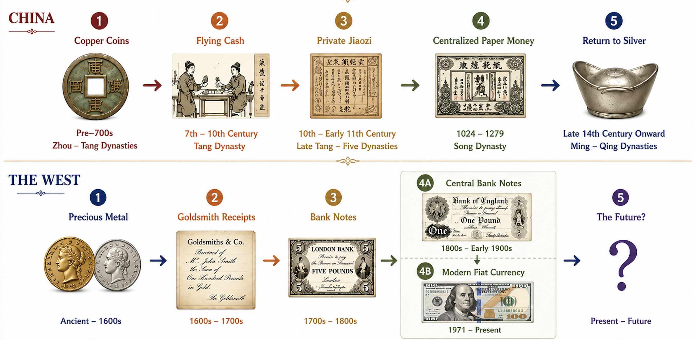
Evolution of Money in China

Slide 4
Step 1: Tokenization
  Tokenization: move claims, not metal
  Better medium of exchange expands the markets
  Standardized
  Divisible
  Heavy!
  “Cashier’s cheque”
  Safe
  Convenient

Slide 5
Step 2: Private Money
Lower transaction costs
↓
Trade
↓
Specialization
↓
Urbanization
  Standardized denominations
  Broader accepted

Slide 6
Step 3: Centralization & Fiatization
Network effect:
  Strongest with a common issuer
Fiatization
  Initially tied to precious metal
  Fiscal pressures weakened convertibility
  Paper became money itself
  Minimal verification cost
  Universal acceptance
  Market integration
“All these pieces of paper are issued with as much solemnity and authority as if they were of pure gold or silver… The Great Khan has mastered the art of alchemy.”
-- Marco Polo

Slide 7
Step 4: Back to Precious Metal
Fiscal pressures weakened issuance discipline
↓
Inflation
↓
Loss of confidence
↓
Return to silver
Alchemy only works as long as people trust the alchemist.
Fiat money requires fiscal credibility

Slide 8
Evolution of Money… Everywhere?
Centralization → FIATIZATION
Metal coin
Tokenization
Private Money
Key difference:
US chose fiat

Slide 9
Why Choose Fiat?
Commodity-backed money ties money supply to commodity markets
Metal discoveries create inflation
  New World silver
Economic growth can create deflation
  Money demand meets Bretton Woods and gold standard
Fiat money ties money supply to economic conditions
Accommodation of money demand, provision of liquidity, stabilization
Commodity money responds to geology – may not be price stabilizing.
Fiat money can respond to the economy – stability and flexibility.

Slide 10
Inevitability of Evolution?
Centralization → Fiatization
Metal coin
TOKENIZATION
Private Money

Slide 11
Is Tokenized Gold the End of the Evolution?
The paper shows tokenization is technologically feasible.
The open question is whether it will become money.
  Will it be widely accepted as its own unit of exchange?
Can commodity-backed money serve the needs of a modern economy?
Even if it can, it likely won’t be the end of the evolution
  Likely centralized
  Possibly nationalized
  Eventually fiatized?

Slide 12
Inevitability of Evolution?
Centralization → FIATIZATION
Metal coin
Tokenization
Private Money

Slide 13
Where to Next for Fiat Money?
Must fiat eventually return to metal?
  Yes, if we lose credibility
Fiat money is worth saving
  Requires institutional credibility
  Fiscal + monetary discipline

Slide 14
Conclusion
“The central message of this Note is that technology alone will not determine the outcome.”
-- Tobias Adrian, IMF Notes on Tokenized Finance
We stand at a critical moment in history
Can we sustain institutional credibility?
  Credibility is the foundation of fiat money
  Requires joint fiscal and monetary discipline
  Not substitutable by technology
Let us build the next chapter in monetary history

